Slide 1
EMPLOYEE ANALYTICS AND TALENT RETENTION
PROJECT INCREMENT-1

Slide 2
WORK FLOW
The workflow of a big data project is determined by the project's specific goals and requirements, and it can be divided into the following stages:
The first stage in any big data project is to collect the data that will be analyzed.
After acquiring the data, it must be cleaned and preprocessed to ensure that it is of good quality and suitable for analysis.
In the analysis phase, statistical and machine learning techniques are used to extract insights from the data, using tools such as Apache Spark, Apache Hive etc.
Feature selection involves choosing the most relevant and valuable features (or variables) in a dataset that are most predictive of the desired outcome.
Model selection involves deciding on the optimal algorithm or model to utilize for a specific task.
Once a model is chosen, it must be trained and evaluated on the data to understand the patterns and correlations between the features and the desired outcome, followed by Model optimization entails fine-tuning the model's performance.
Once the analysis is completed, the results must be visualized in an understandable manner, including developing charts, graphs, or dashboards to present the data.

Slide 3
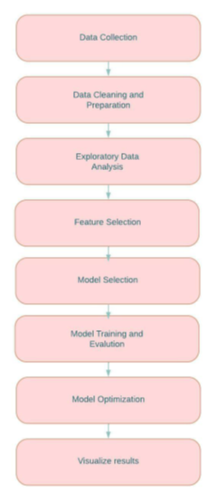
WORK Flow DIAGRAM

Slide 4
ARCHITECTURE
Data Source: It is the location from where the data is obtained. Two distinct data sources are employed in this architecture: Excel, MySQL.
Data ingestion: Cassandra is used for data ingestion in preparation for subsequent processing. It can handle massive amounts of data and is designed for quick data writing.
Cleaning and analyzing the data: The next stage is to clean and analyze the data. Spark and Pyspark are utilized for data cleansing and analysis in this architecture.
Data visualization: The final stage is to visualize the data analysis results. Matplotlib,seaborn is utilized for data visualization in this design.

Slide 5
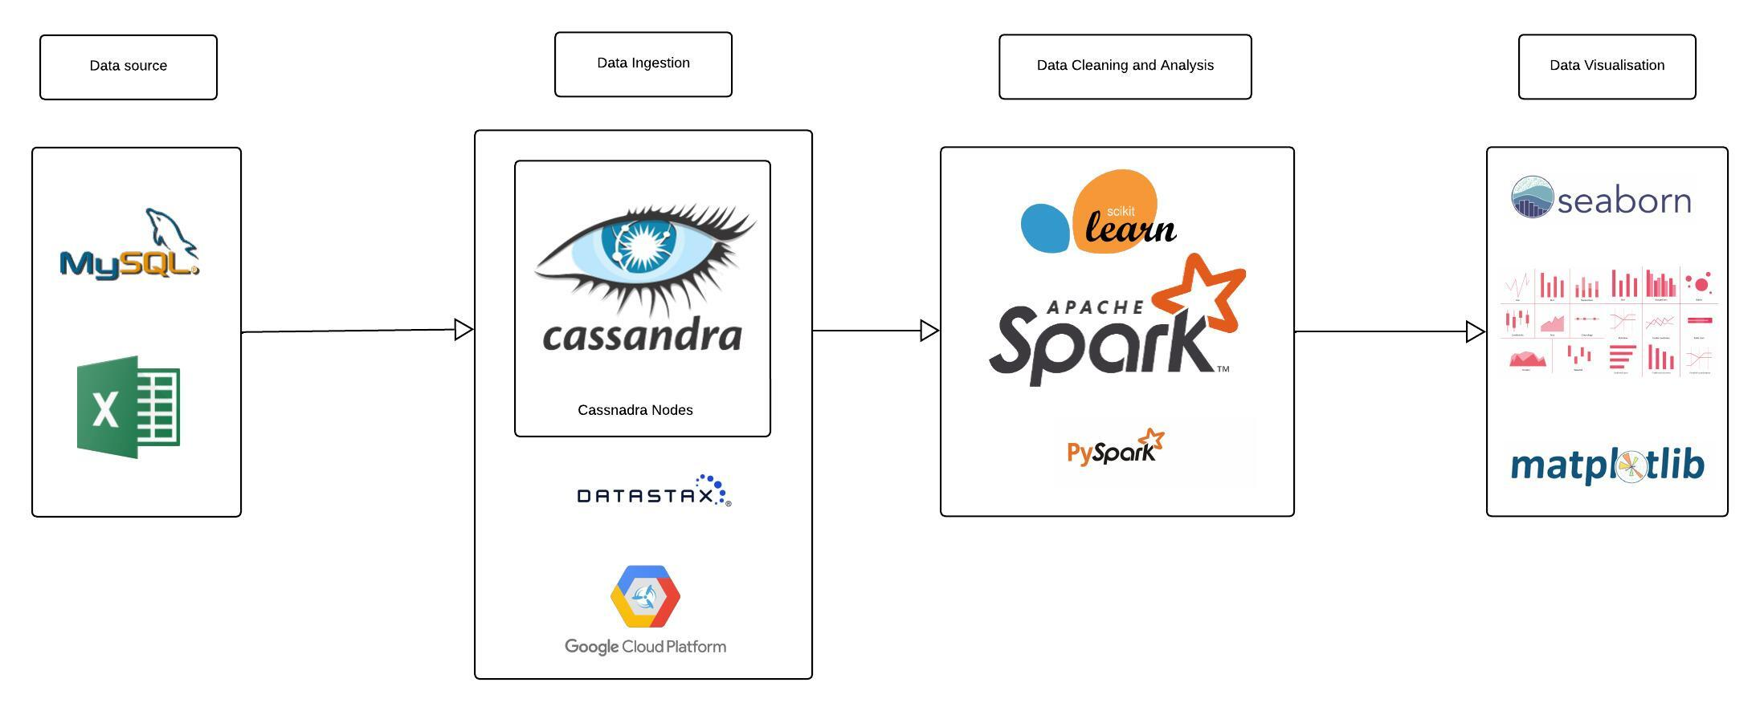
Architecture DIAGRAM

Slide 6
Features
The following are the attributes that are considered as features to predict whether an employee leaves the company.
• Satisfaction: An employee’s level of satisfaction in percentage
• Evaluation: An employee’s evaluation score in percentage
• Project Count: The amount of projects the employee has done
• Average Monthly Hours: The total monthly hours an employee worked
• Years At Company: The number of years an employee was at the company
• Work Accident: Whether an employee had any accidents at work or not, where 0 (zero) means no and 1 (one) means yes
• Promotion: Whether an employee had a promotion within the last five years, where 0 (zero) means no and 1 (one) means yes.
• Department: The type of department an employee worked under. Which includes sales, accounting, HR, technical, support, management, IT, product management, and marketing. It is categorical data.
• Salary: The type of salary an employee gets, which ranges from low, medium, or high. It is categorical data.

Slide 7
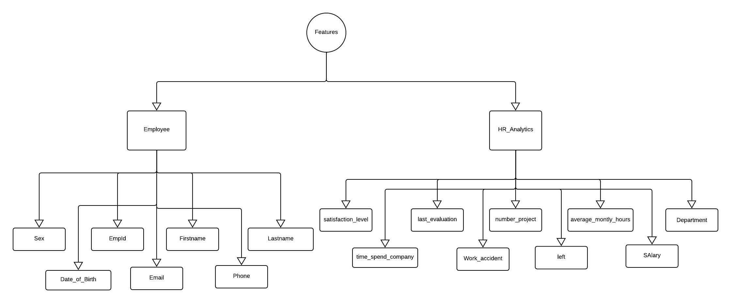
Features

Slide 8









Tools used

Slide 9
MODEL FLOW
Here in this model we collect the data from different sources and explore the dataset using python.
The data is explored we then clean the data and get it ready for analysis.
After the data is cleaned it is splitted into training and test data. In our case we choose 70% training data and 30% test data.
The selected classifier is fed with the training data to train the model.
Once the model is trained we provide the test data to predict the results and to calculate the different metrics to evaluate the efficiency and performance of the model.

Slide 10
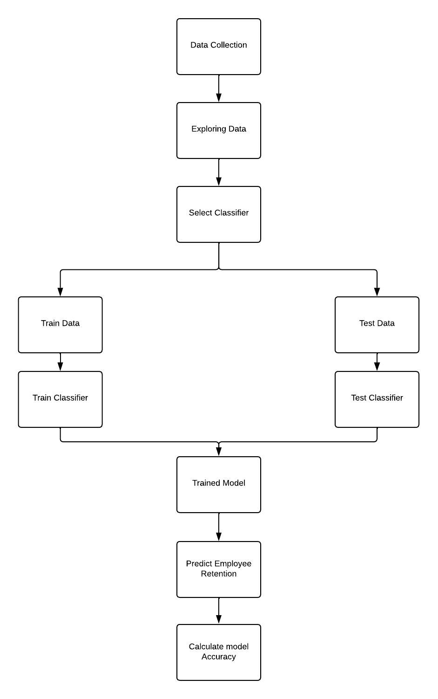
MODEL FLOW

Slide 11
DATA COLLECTION/STORAGE

Slide 12
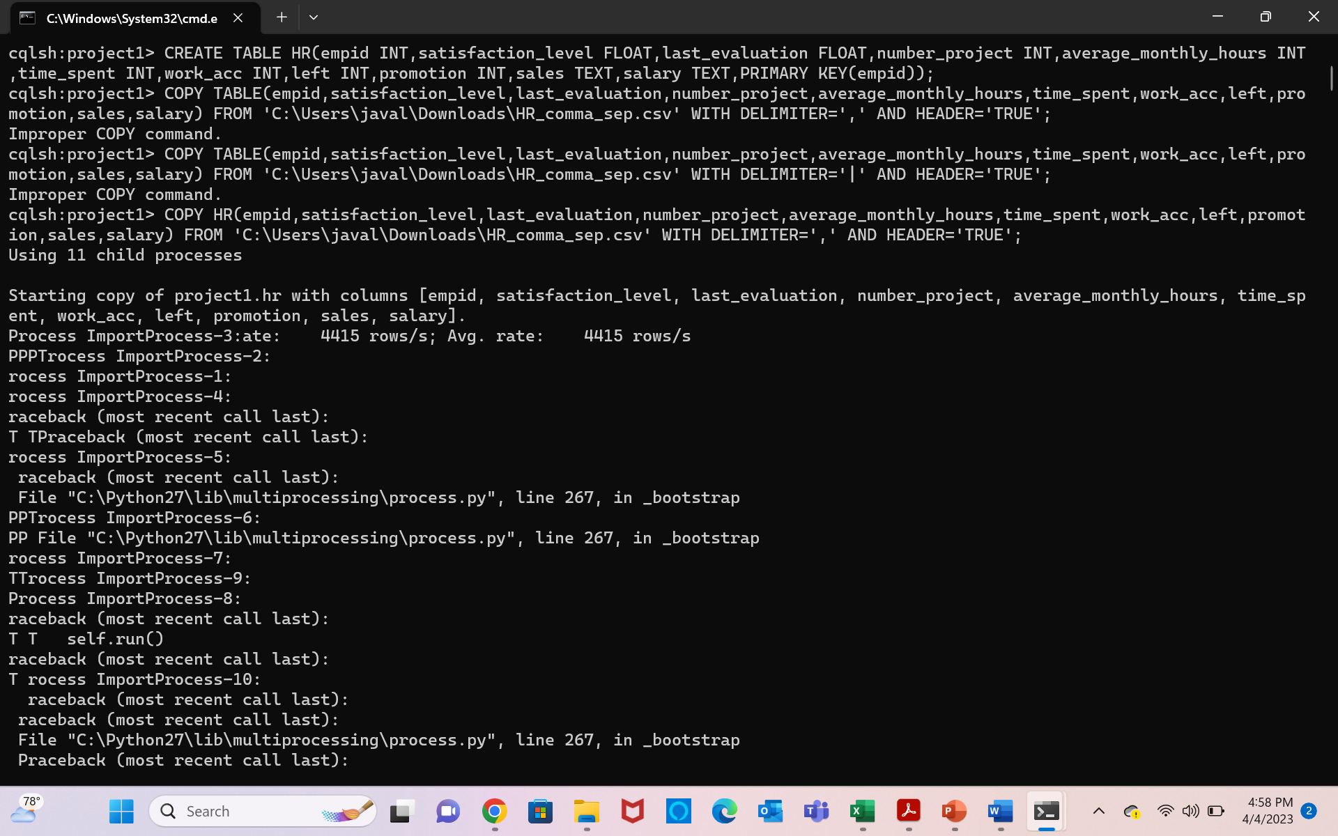
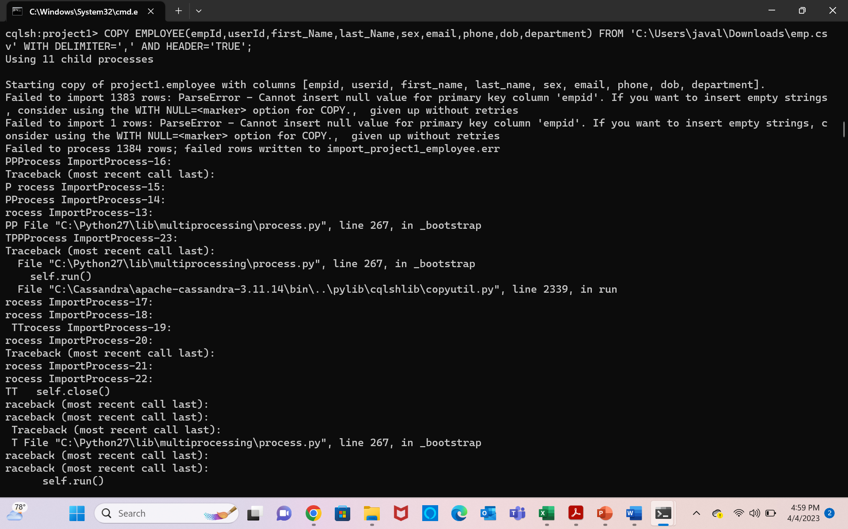
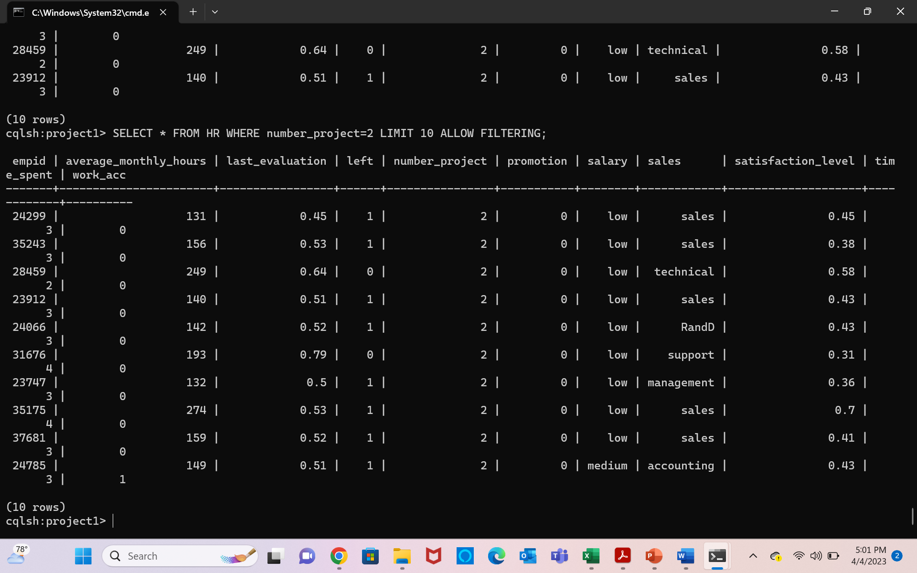
Used Casandra to create keyspace(Database) and Tables in for the employee and HR

Slide 13
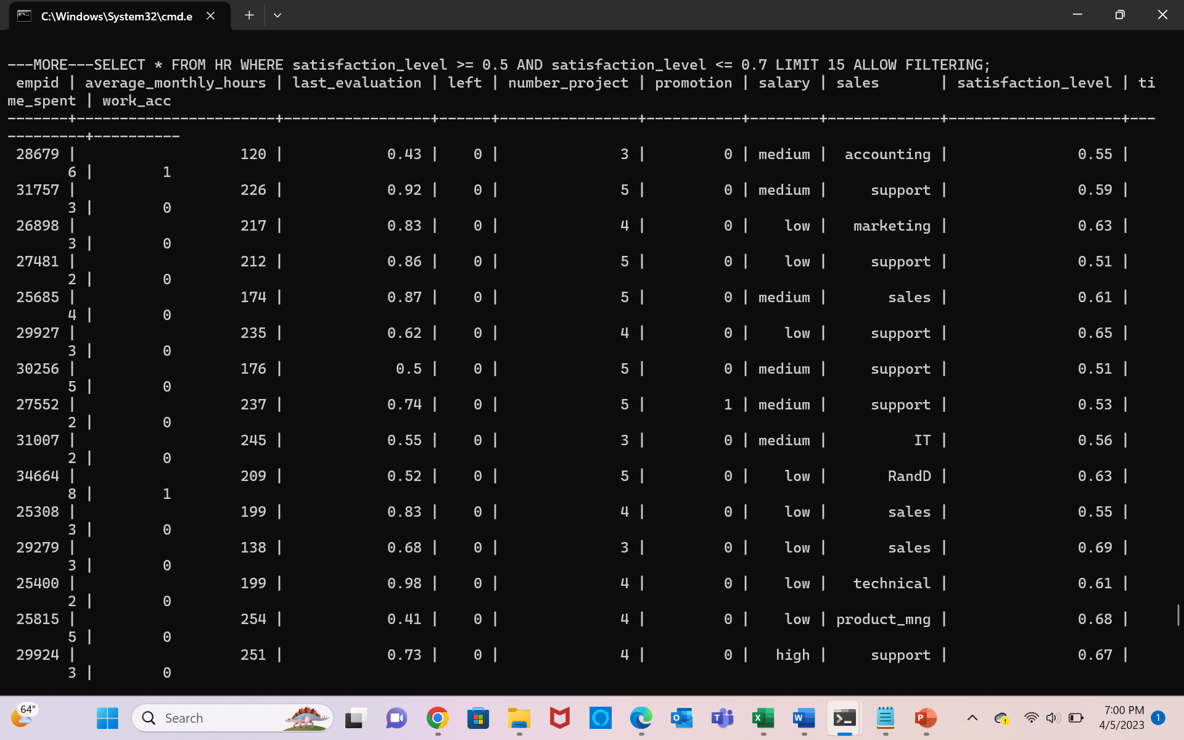
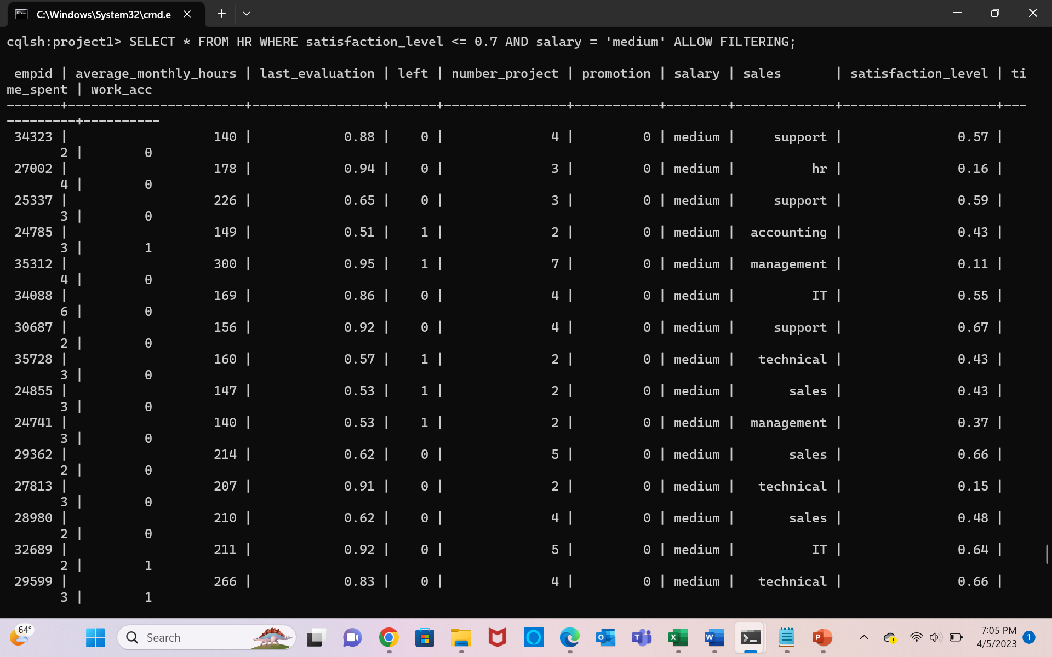
CQL Queries to retrieve data with filtering some column details for HR Table

Slide 14
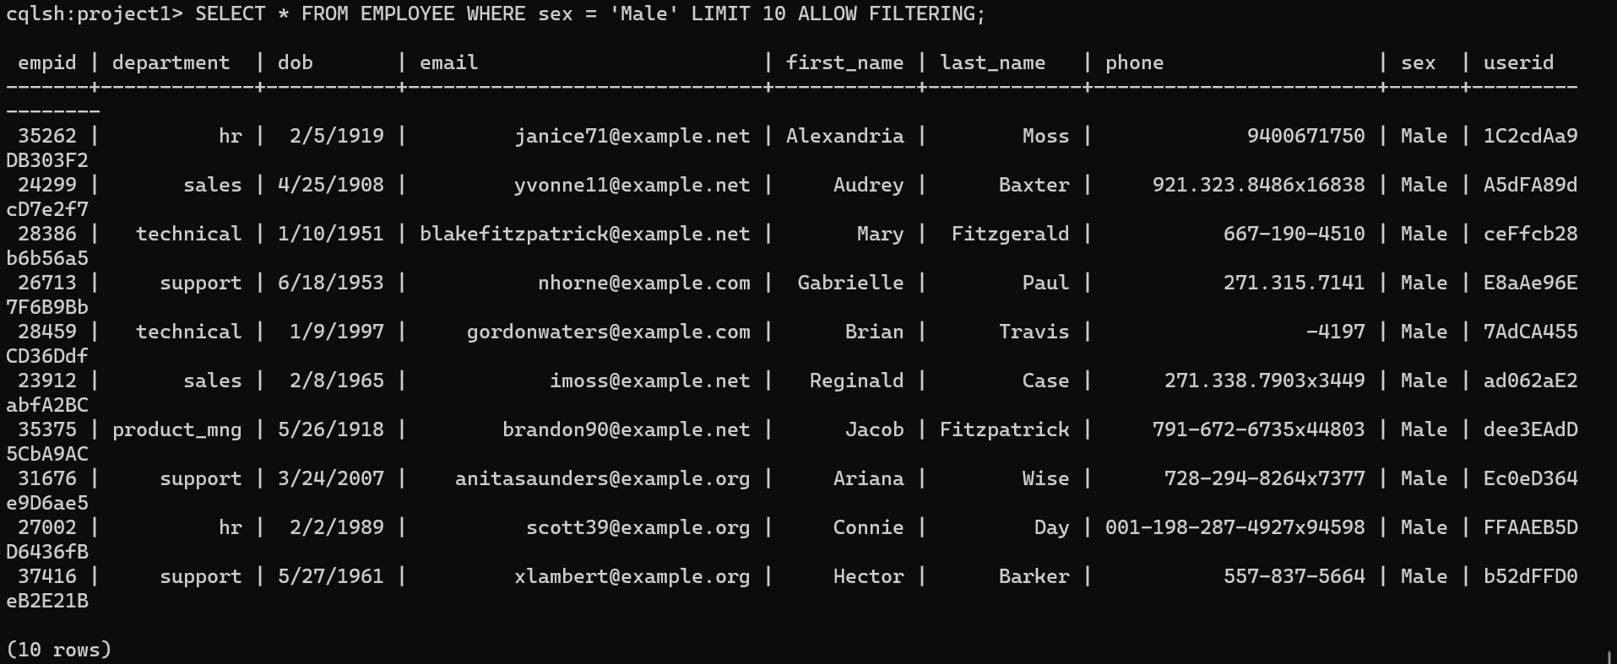
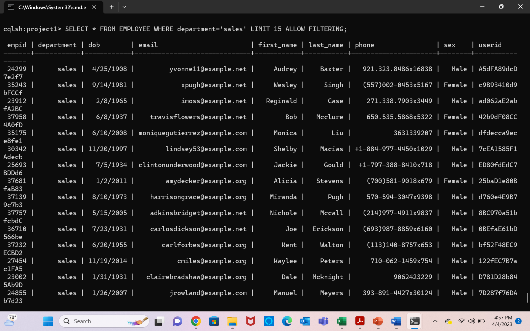
CQL Queries to retrieve data with filtering some column details for Employee Table

Slide 15
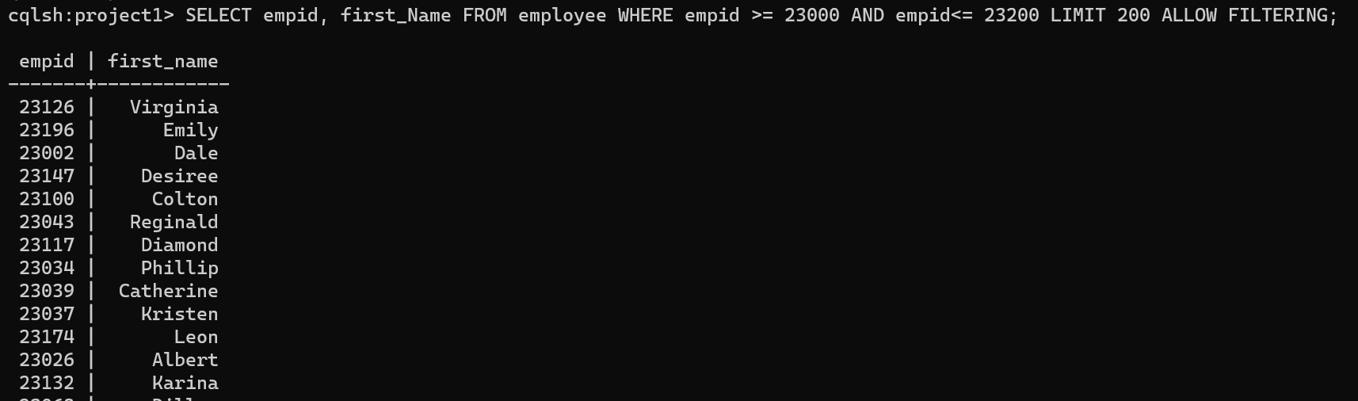
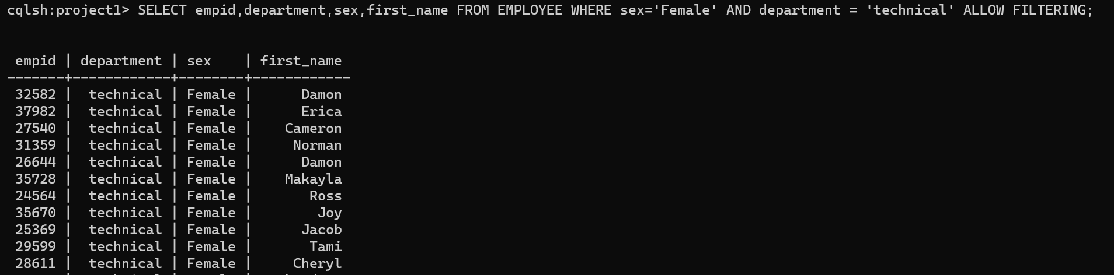
CQL Queries to retrieve data with filtering some column details for Employee Table

Slide 16
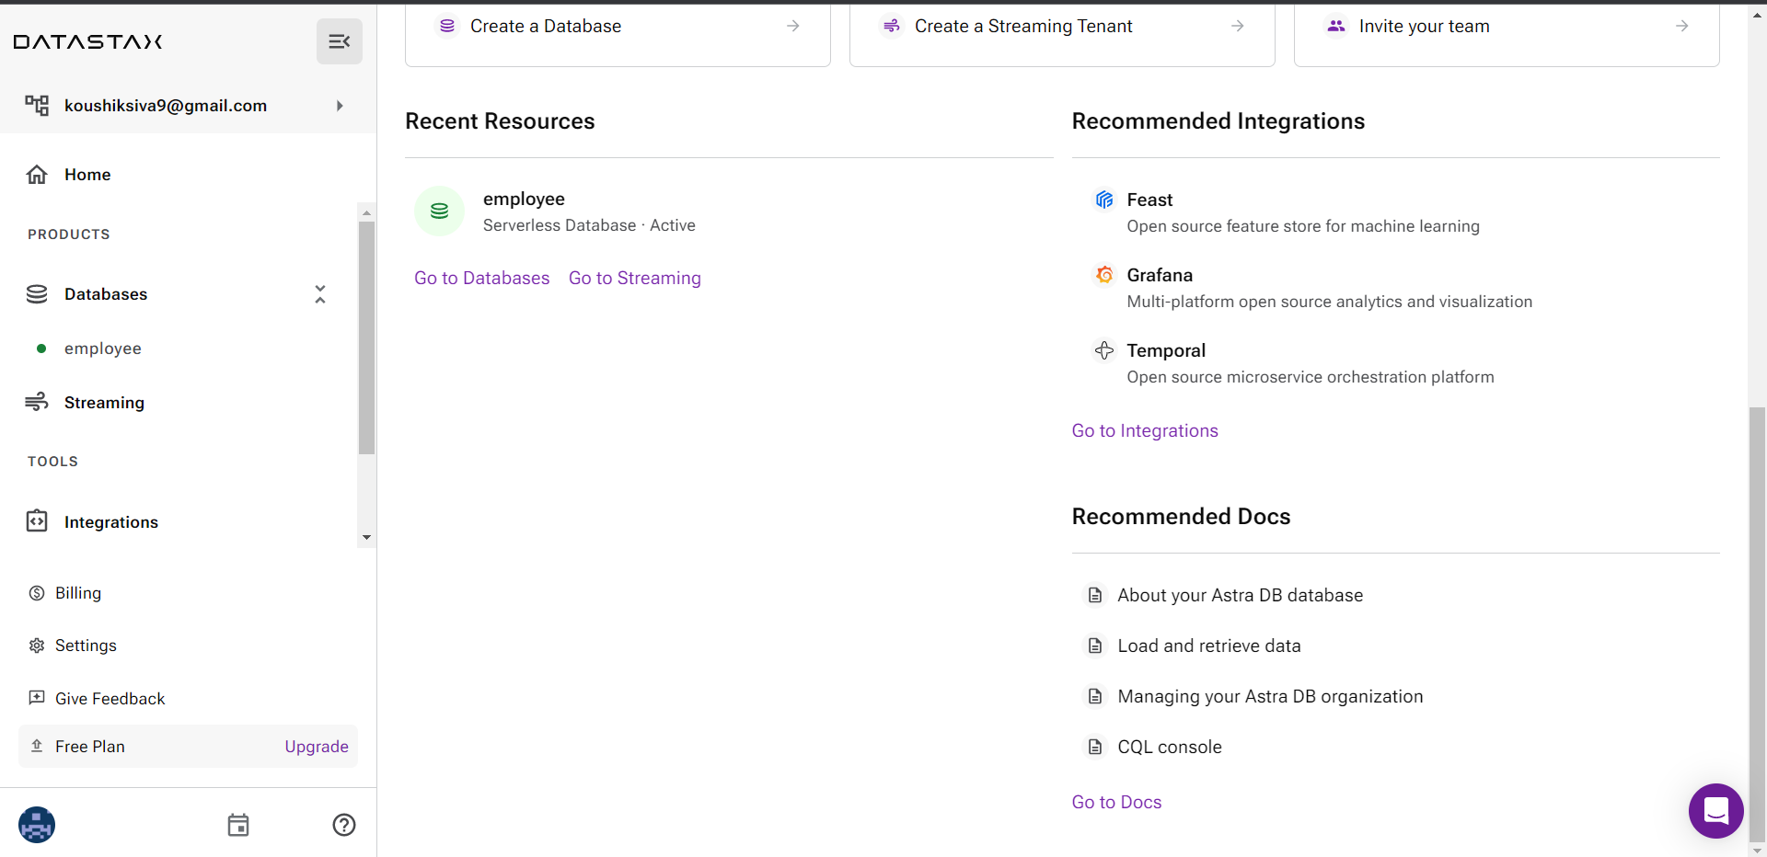
Data Cloud storage

Slide 17
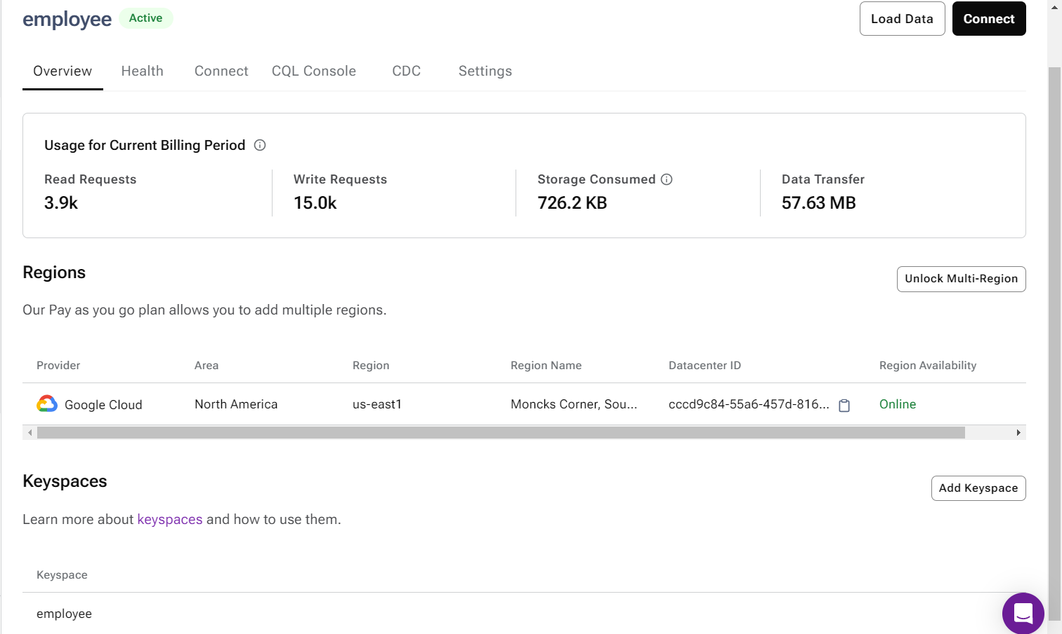
Data Cloud storage

Slide 18
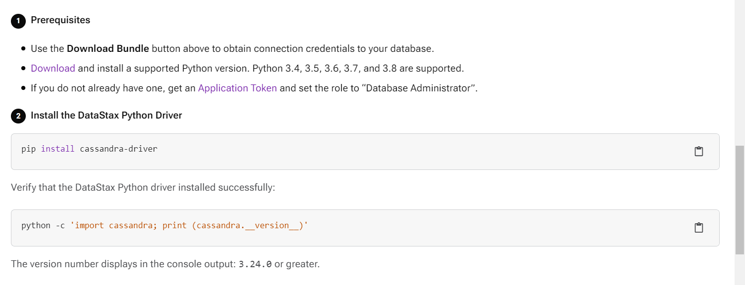
Data Cloud Driver

Slide 19
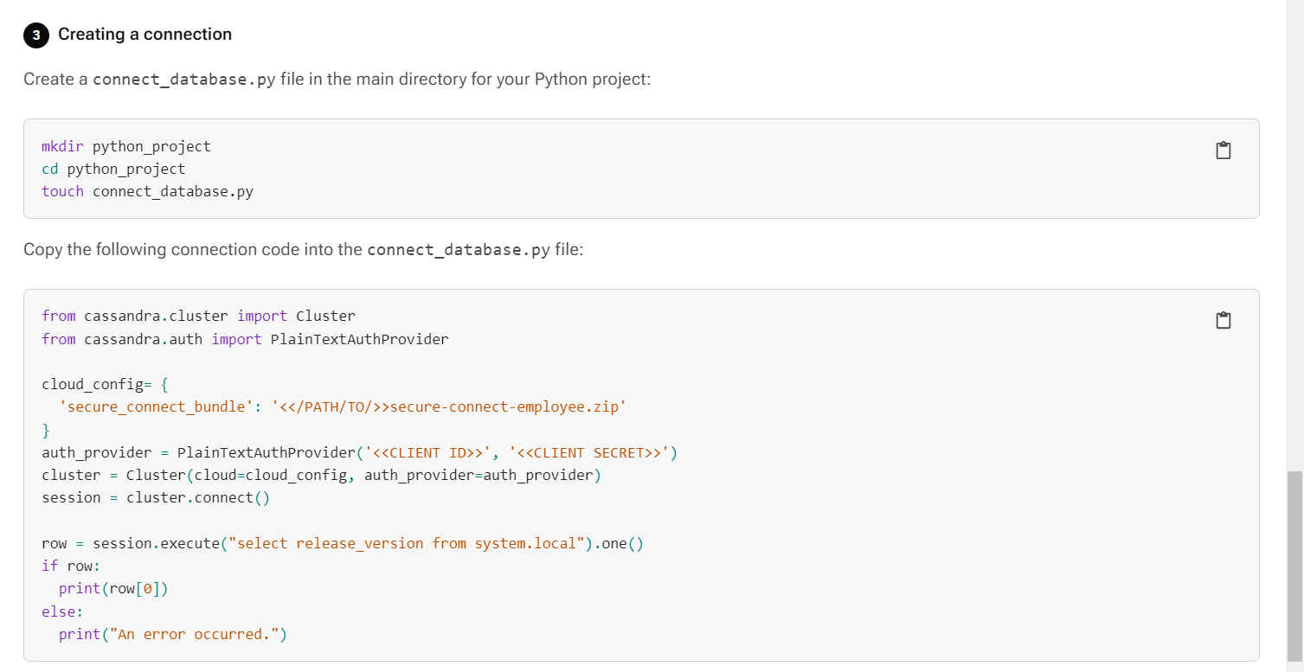
Data Cloud Driver

Slide 20
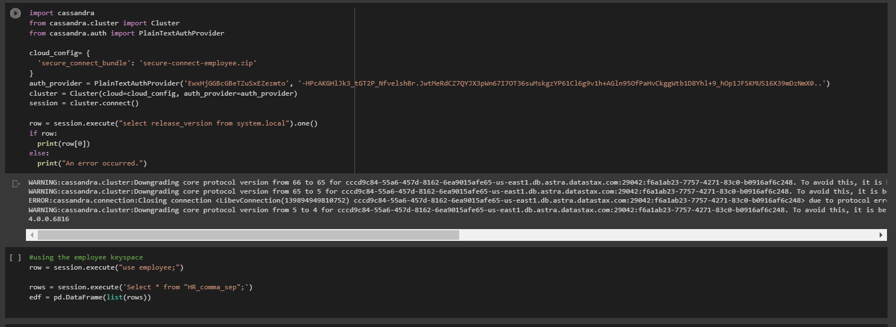
Data COnnection

Slide 21
Cleaning and Preprocessing

Slide 22
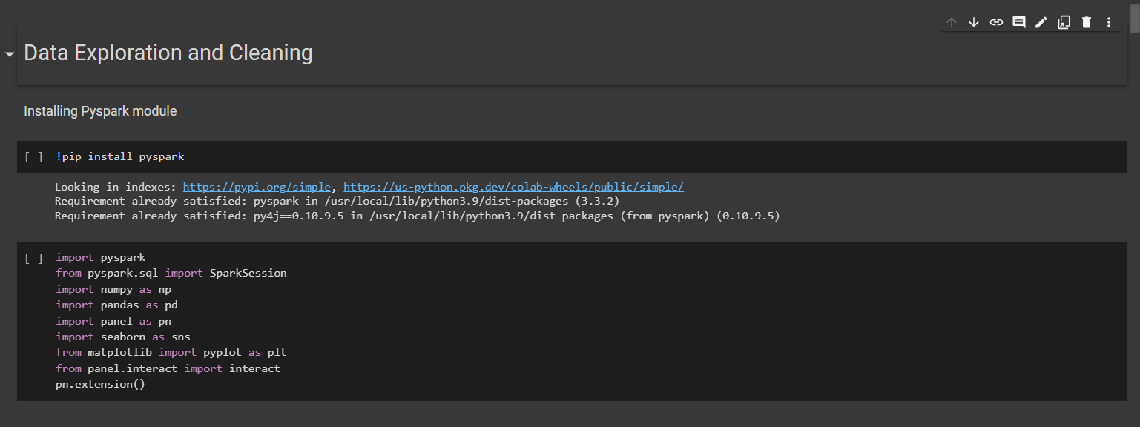
Data exploration and cleaning

Slide 23
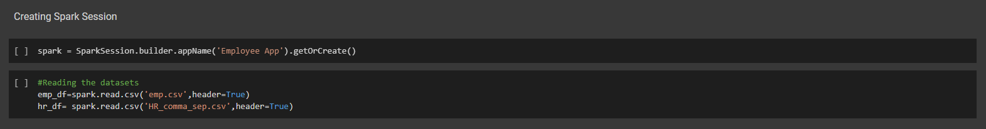
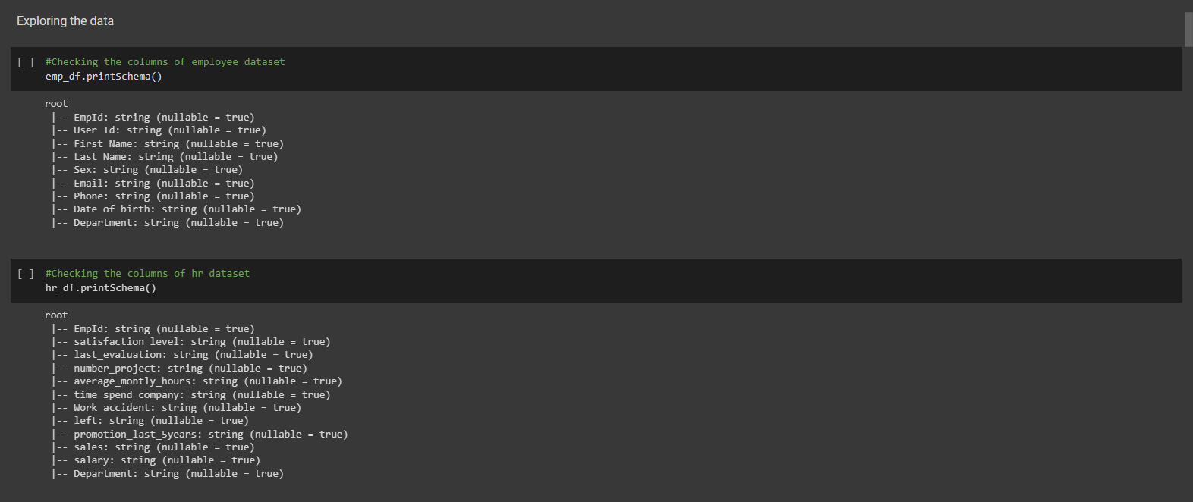
Data exploration and cleaning

Slide 24
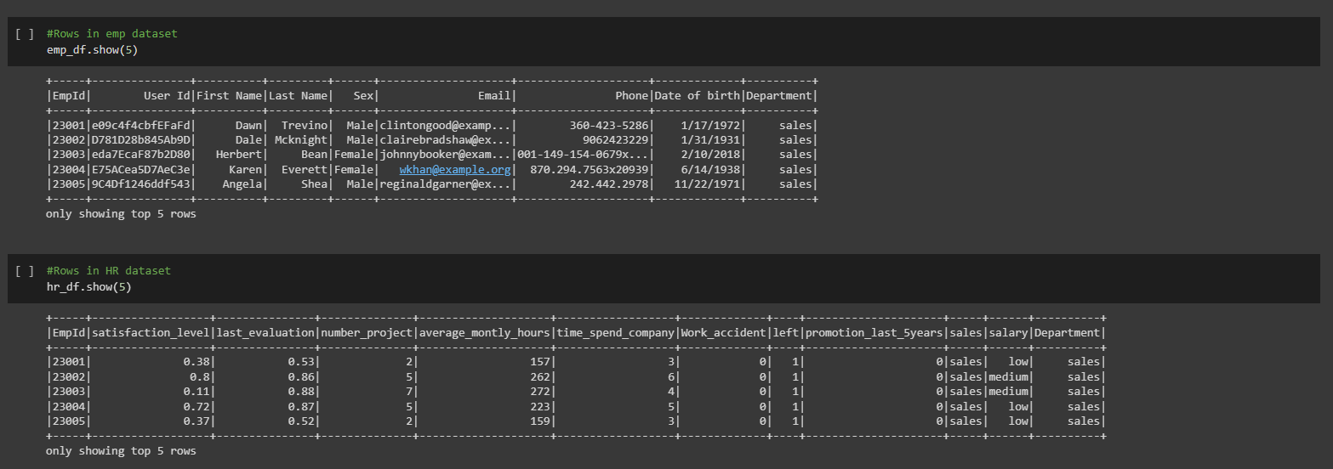
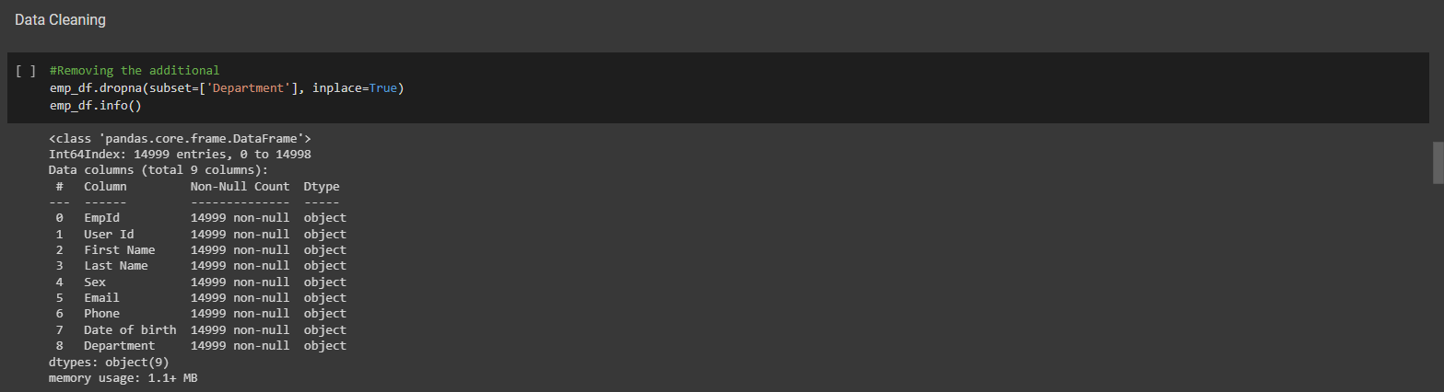
Data exploration and cleaning

Slide 25
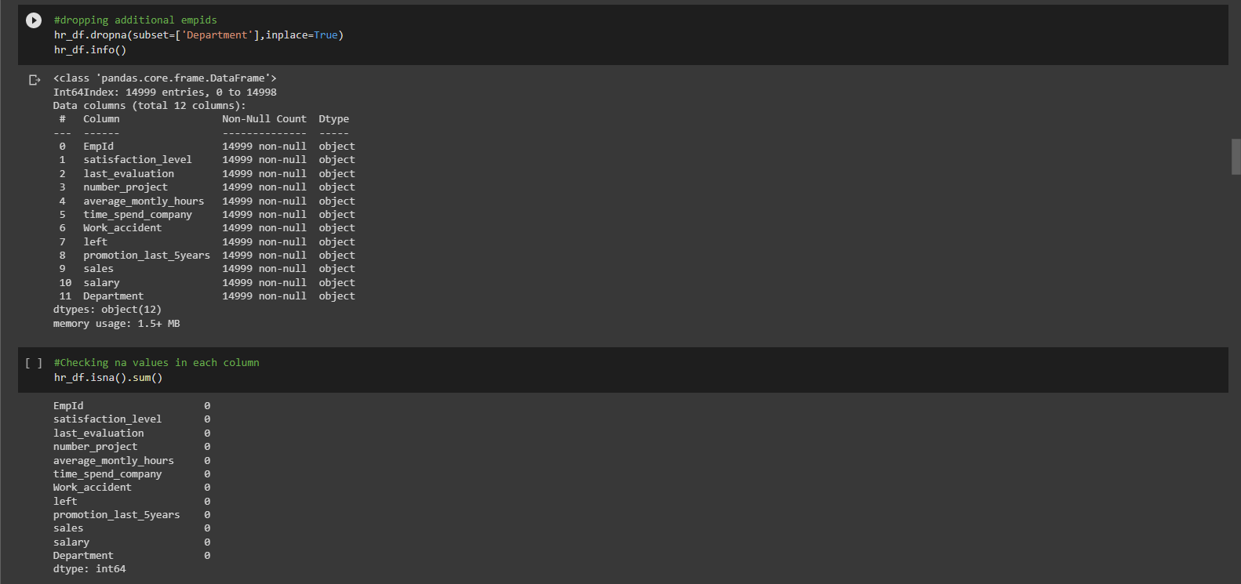
Data exploration and cleaning

Slide 26
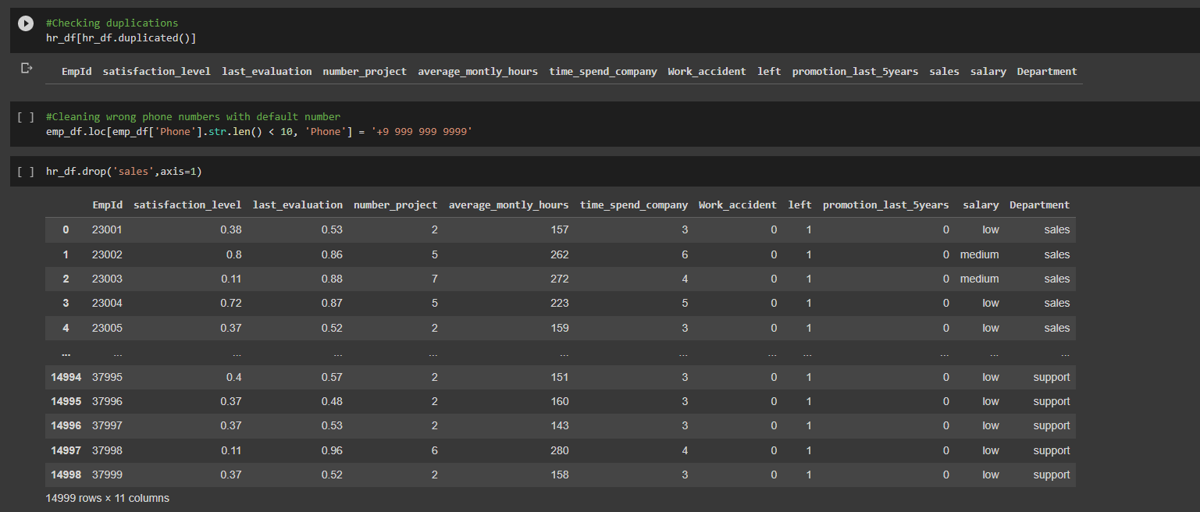
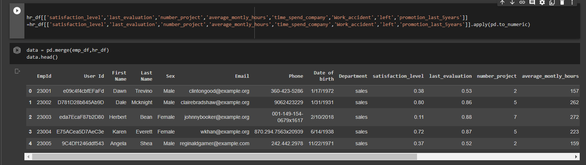
Data exploration and cleaning

Slide 27
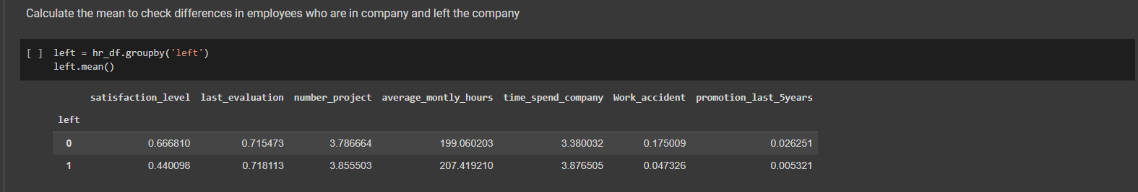
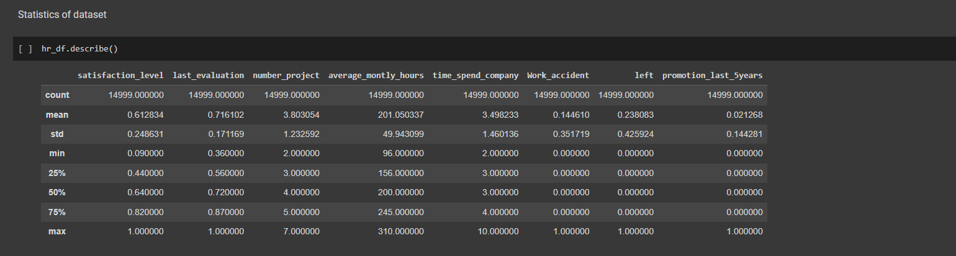
Data exploration and cleaning

Slide 28
Visualisation

Slide 29
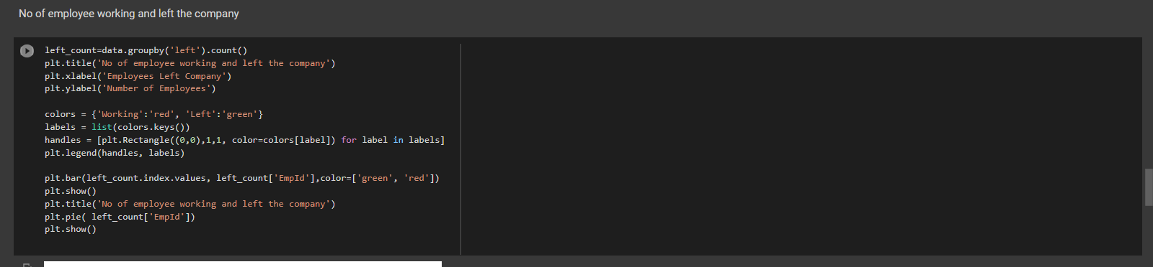
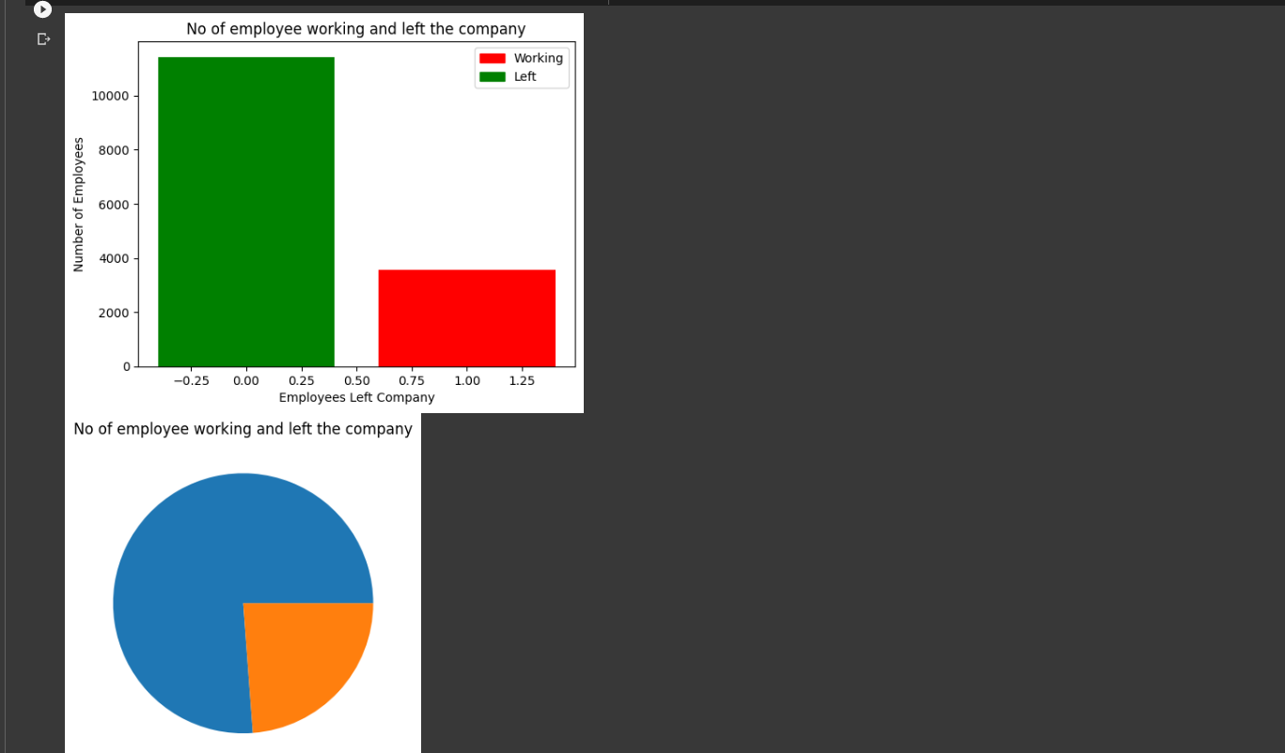
Data visualization

Slide 30
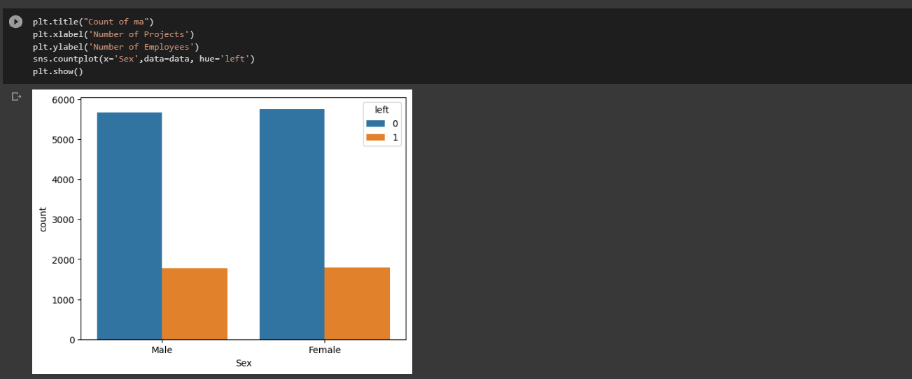
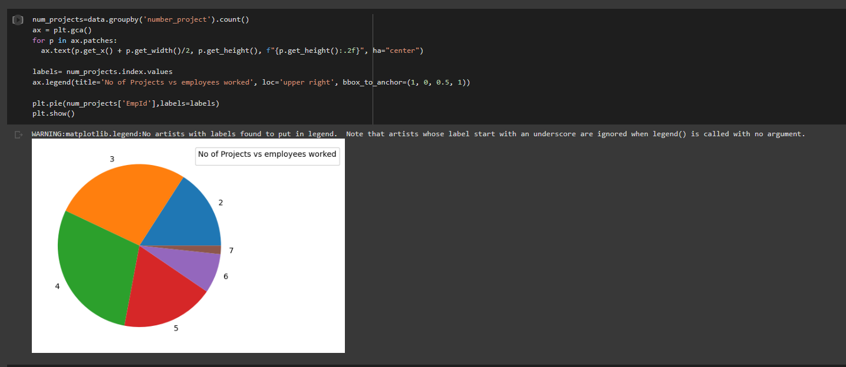
Data visualization

Slide 31
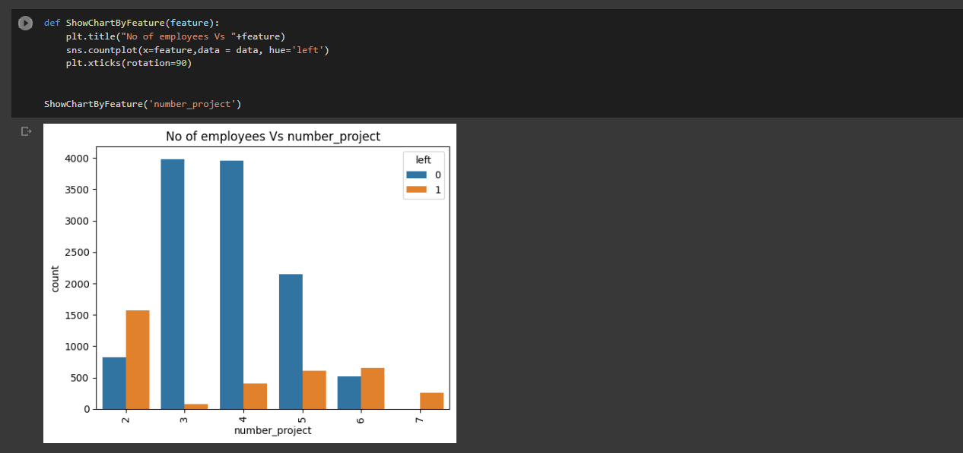
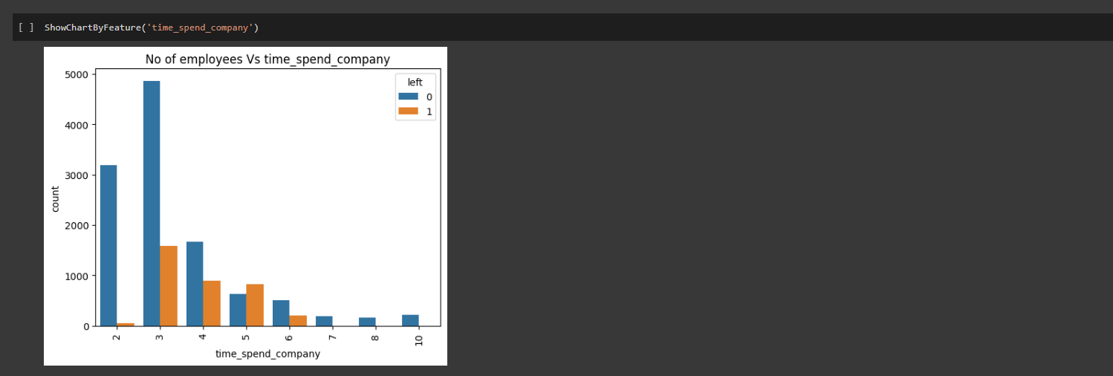
Data visualization

Slide 32
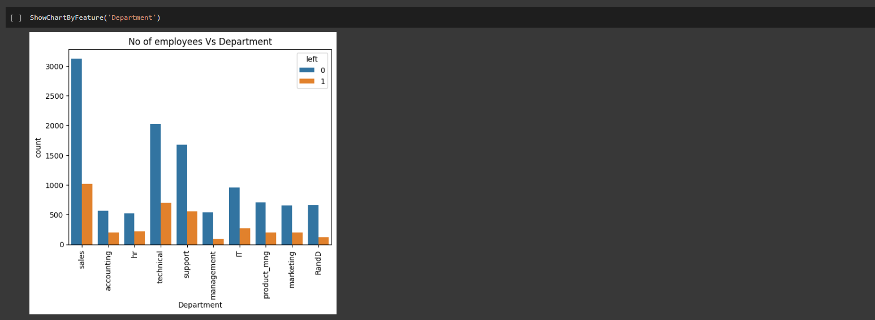
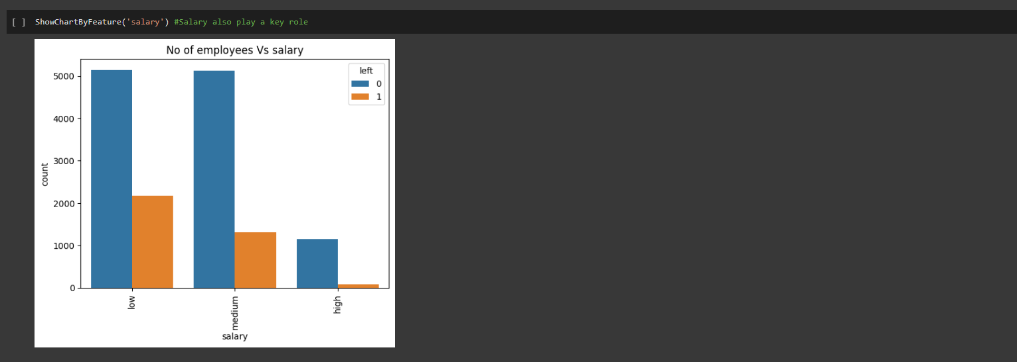
Data visualization

Slide 33
Algorithm IMPLEMENTATION

Slide 34
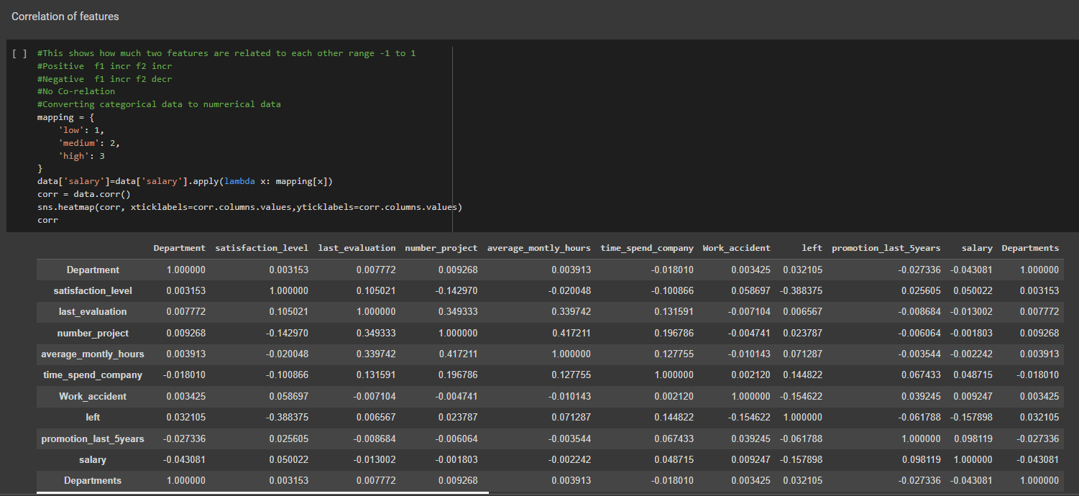
Data Analysis

Slide 35
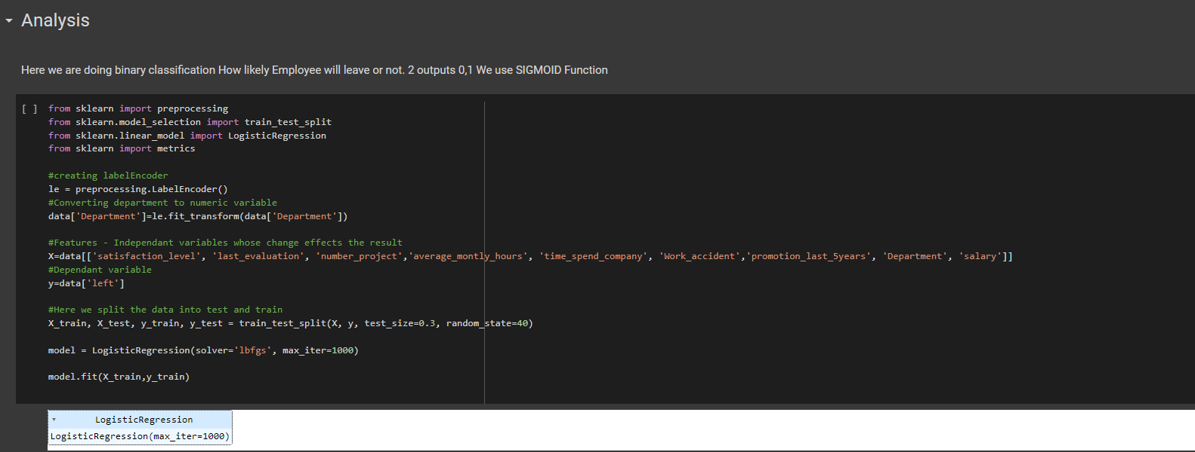
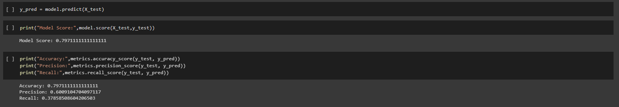
Data Analysis

Slide 36
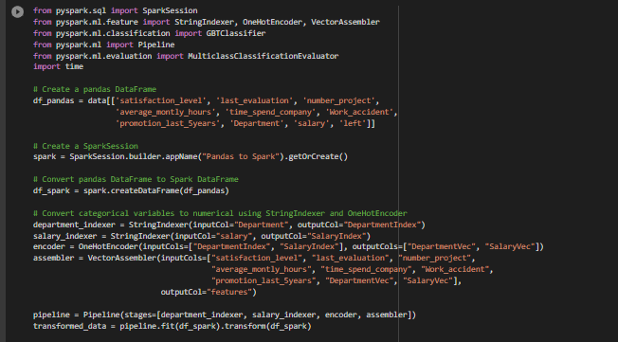
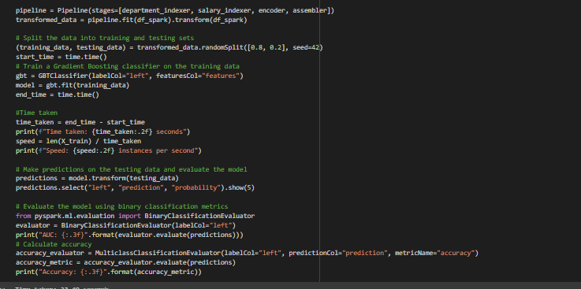
Data Analysis

Slide 37
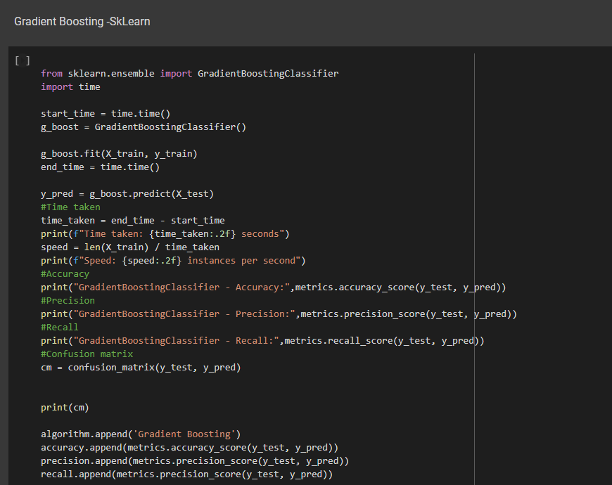
Data Analysis

Slide 38
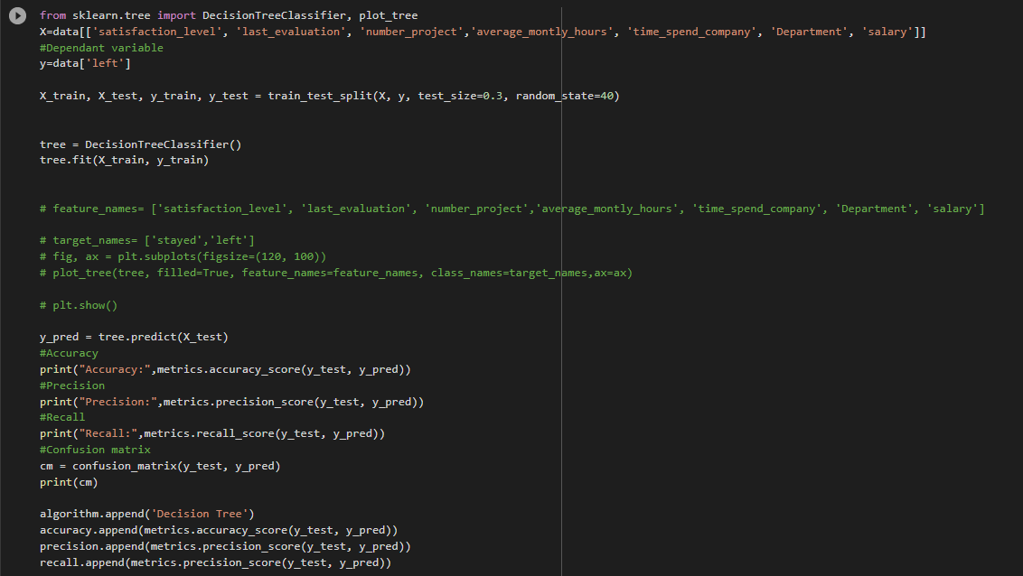
Data Analysis

Slide 39
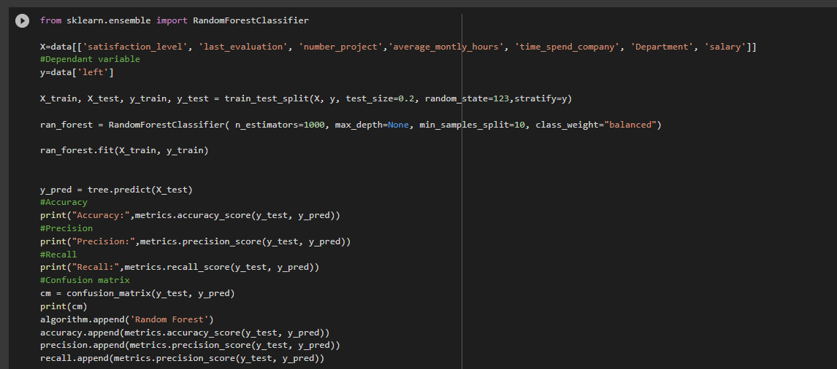
Data Analysis

Slide 40
Result

Slide 41
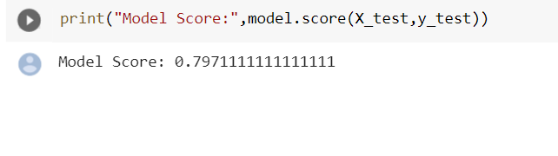
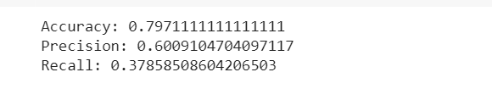
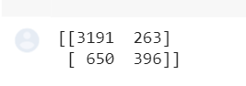
Logistic Regression

Slide 42
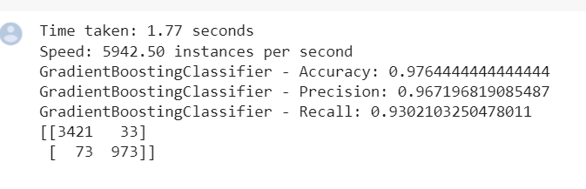
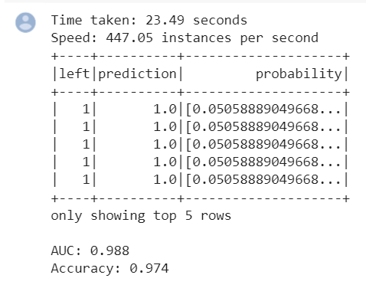
Gradient Boosting

Slide 43
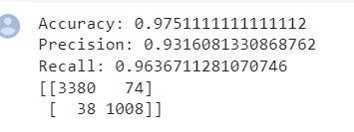
Decision Tree

Slide 44

Random Forest

Slide 45

Accuracy

Slide 46

Precision

Slide 47

Recall

Slide 48
THANK YOU

